Slide 1
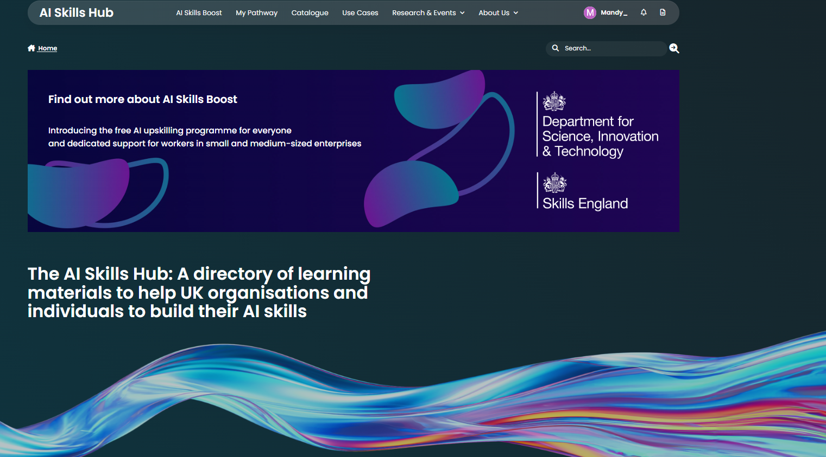
AI Skills Hub – First Impression

Slide 2
What Is the UK AI Skills Hub?
  Government initiative offering (some) free AI training for all UK adults with the aim to upskill 10 million workers by 2030
  Industry-developed courses benchmarked against new national AI foundation skills standards
  1M+ courses completed
  Integrated with Innovate UK’s BridgeAI Programme, supporting AI adoption across key sectors

Slide 3
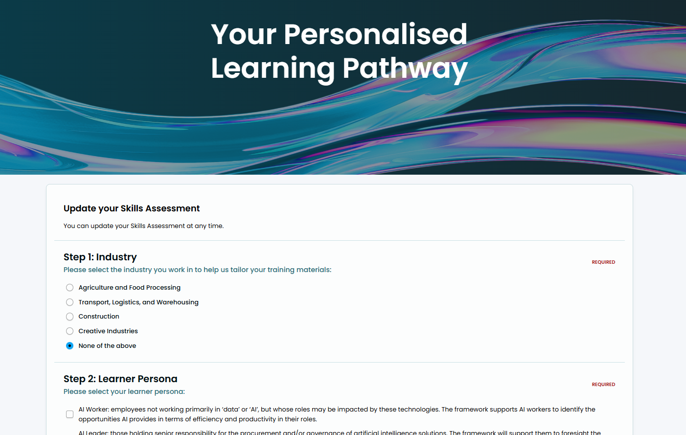
UK AI Skills Hub Offer
Online directory to help businesses and professionals in underrepresented sectors to develop AI skills understand AI applications, and drive adoption.
Mapping tool available to develop personalised pathway [4 questions]
Tailored learning pathway

Slide 4
UK AI Skills Hub
Over 500 courses available
Industry | Provider | Duration | Price | Level | Technology Stack
General Agriculture & Food Transport Construction Creative Industries | Universities & Academic Institutions Online learning platforms Corporate training providers Industry Associations Specialised Training Centres | Varies between 1hr to more than 4wks Part-time Full-time Duration unknown | No charge Fee payable | Beginner Intermediate Advanced | IBM Microsoft Google Amazon (AWS) Other SAS Accenture Sage Salesforce
Expanding to include public sector-focused training

Slide 5

Honest Opinion…
As a learning platform – feels flat for the free courses
Links require registration to external sites
Good to use as a central place for signposting

