Slide 1
Business Continuity in Further Education: Building Organisational Resilience

Slide 2
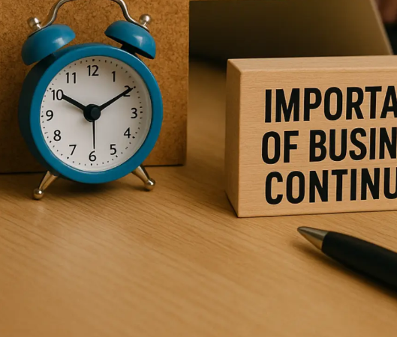
Why Business Continuity Matters Now…
Security
Increasing operational complexity
Digital dependency
Cyber threats
Sector pressures
Notes:
“Further Education organisations are increasingly interconnected and digitally dependent, which means resilience planning has become essential to maintaining learner experience and operational stability.”

Slide 3
What Business Continuity Means in FE
Life preservation
Media and communications
Continuity of Learning
Recovery
Continuity of Operations
maintaining critical services
protecting learners and staff
sustaining teaching and operations during disruption

Slide 4
Disruption is now broader than traditional disasters
Key Risks Facing FE
Cyber incidents
Terrorist/Marauding Attack
Estates/utilities
Staffing disruption
Severe weather
Data/system outages
Pandemic / Communicable Disease
Critical Functions to Protect
Teaching & learning
Safeguarding
MIS and student data
Exams/assessment
Communications
Payroll/HR
Notes:
Moving beyond “fire/flood” Include:
cyber incidents
ransomware
staff shortages
severe weather
utility outages
supplier failure
cloud/system outages
industrial action
pandemic lessons
safeguarding incidents
reputational crises

Slide 5

What Effective Continuity Looks Like
“A continuity plan is only effective if people understand it, test it and can apply it under pressure.”
Clear ownership (Leadership)
Defined escalation
Tested plans
Communication protocols
Recovery priorities
Staff awareness
Notes:
leadership ownership
operational readiness
staff awareness
testing and exercising
communication planning
decision-making capability

Slide 6

Building Organisational Resilience
Training
Exercises
Cross-team coordination
Governance review
Supplier assurance

Slide 7
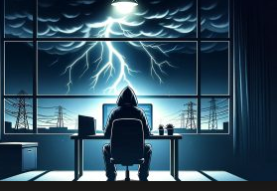
Disruption is now broader than traditional disasters
Lessons Learned from Recent Disruptions –
pandemic learning
ransomware cases
power failure
severe weather conditions

Slide 8

Discussion / Q&A
Questions:
Where are your key vulnerabilities?
How tested are current plans?
Which services are truly critical?
Are staff confident in escalation processes?

