Slide 1


Getting E & M right for vulnerable and disadvantaged learners
Louisa Hubbard

Slide 2
Session Aims
Planning for inclusion:
Strategy - pledge
Knowing your students/ Monitoring attendance
Monitoring for gaps/group profiles
How can pedagogy break down barriers?
Marking
RESO
Developing exam resilience
Next year’s strategy

Slide 3
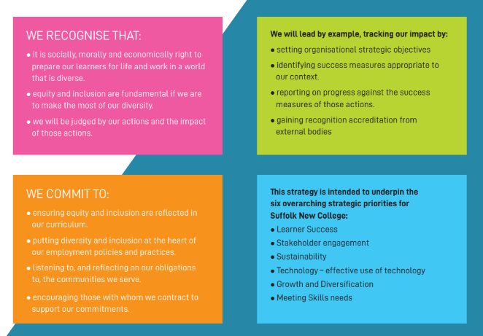
Inclusion Strategy

Slide 4
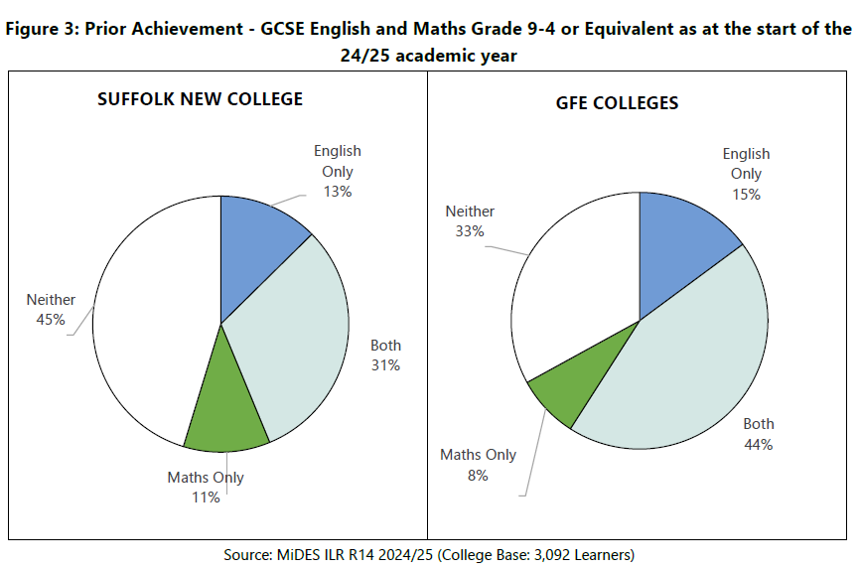
Our students - prior achievement
Notes:
(91% worst for English and 82% for maths) For English pass rate, we rank 116 out of 217 colleges (53%) This is an improvement of 86 places. For maths pass rate we rank 130 out of 218 (59%). That is an improvement of 53 places.

Slide 5

Expected
1)Leaders and staff promote and reinforce high expectations for attendance and participation for all learners and apprentices, in particular those who are disadvantaged, those with SEND or high needs, those who are known (or previously known) to social care, and those who may face other barriers to their learning and/or well-being, including those without level 2 English and/or mathematics
2) Leaders identify the reasons why certain learners and apprentices do not attend or participate regularly, particularly those who are disadvantaged, young carers and those groups listed above. Leaders’ actions support learners and apprentices to re-engage with their studies.
Notes:
how leaders ensure that learners and apprentices are supported to attend and participate well in their studies, including those who are disadvantaged, those with SEND or high needs, those who are known (or previously known) to social care, and those who may face other barriers to their learning and/or well-being, such as young carers and those without level 2 English and/or mathematics; this includes support for those at risk of becoming NEET . Clear Expectations
Consistent messaging
Attendance as a professional behaviour
Strong induction
Staff modelling punctuality

Slide 6

Needs Attention
Leaders understand the importance of attendance and have suitable expectations, but their work to identify and tackle low attendance and/or barriers to attendance is inconsistent and lacks focus. As a result, attendance for some groups of learners and apprentices shows limited or unsustained improvement, and this hinders their progress.

Slide 7

7 whys project. Leading to 7 ways to support attendance.

Slide 8
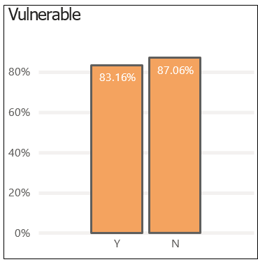

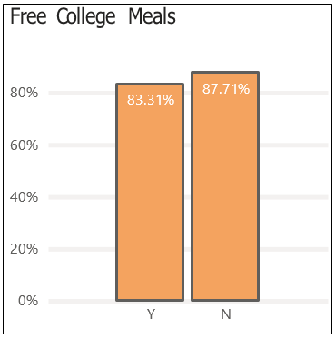
Attendance at SNC (By demographic) for overall study programme
Notes:
Vulnerable 3.9%, disadvantaged 2.68%, FCM = 4.4%

Slide 9

Monitoring for gaps
Vulnerable and disadvantaged meetings
https://ebsreportsnc.suffolk.ac.uk/ReportsPowerBI/powerbi/Learner%20Tracker
Bursary students receive CGP revision books to take away, scientific calculators and maths sets. These are appropriately assigned by the classroom teacher.

Slide 10
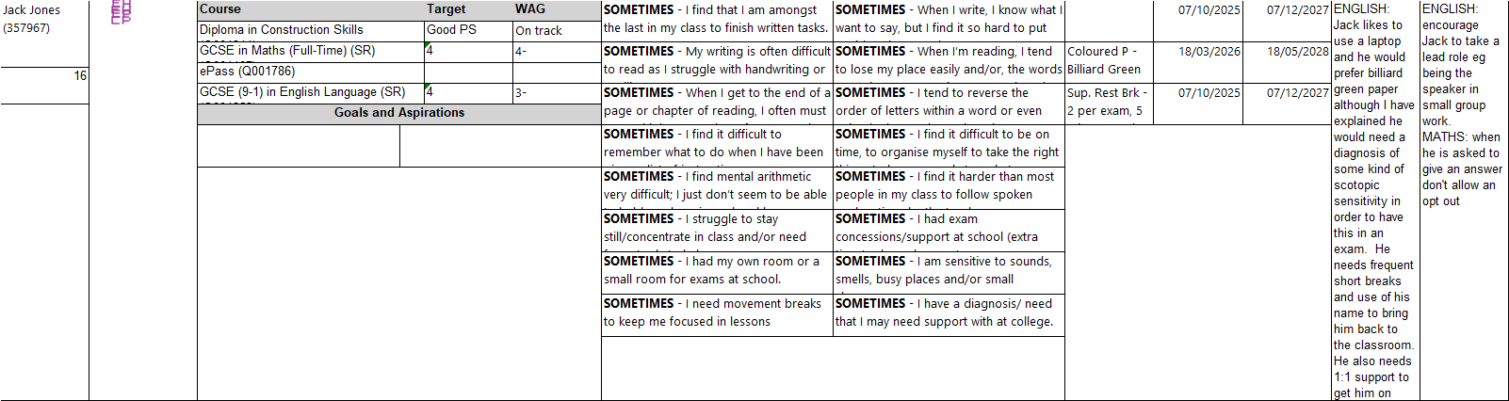

Inclusive Assessment -Using the group profile.
Notes:
Early Intervention
Same‑day contact
First 42 days focus
Attendance tutorials
Clear thresholds (92% concern, 85% persistent absence)
Multi‑agency support where needed

Slide 11

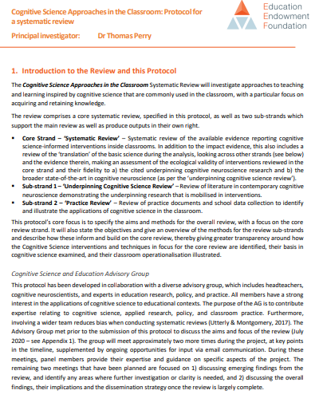
How can pedagogy break down barriers to learning E and M?
Paired learning and peer interaction (rising up 3 percentile points) . A teacher increasing scores by that amount for her class of 30 generates an additional £150k of lifetime income for her students, every year. (For English, not maths)
They use the main 5: Spaced practice; Interleaving; Retrieval practice; Dual coding; (strategies to manage) cognitive load.) and how they might actually *hinder* progress in maths and English if we focus too much on utilising them. It’s a framework, but doesn’t replace pedagogy and the importance of connection
Notes:
https://www.nuffieldfoundation.org/wp-content/uploads/2022/05/Burgess-Characterising-Effective-Teaching-Short-Paper-April-2022.pdf

Slide 12
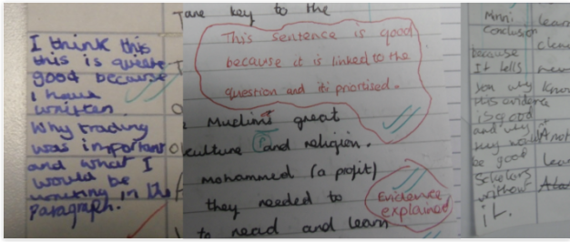
Inclusive Assessment - Addressing Attainment Gaps
Individual barriers to achievement must be identified early through the effective use of diagnostic and performance data. Learners should not be treated as homogeneous cohorts; instead, teaching, assessment, and support strategies must reflect individual needs.
Formative Assessment: The marking of formative assessments (e.g. written work, presentations, practical tasks) for vulnerable learners should be prioritised. Feedback—whether written or verbal—must be provided to these learners first once marking is complete and connection between student and tutor prioritised.
Notes:
Evidence from the Education Endowment Foundation (2021) indicates that lower-attaining learners benefit from more explicit, structured feedback. Feedback should therefore:
Be clear, specific, and focused on improvement.
Use a combination of written and verbal methods, recognising that:
Verbal feedback provides immediacy, clarification, and emotional engagement.
Written feedback provides a clear, lasting record for future reference.
For vulnerable learners, verbal feedback should be routinely used to reinforce and check understanding of written feedback. Where possible, this should take place on a 1:1 basis.

Slide 13
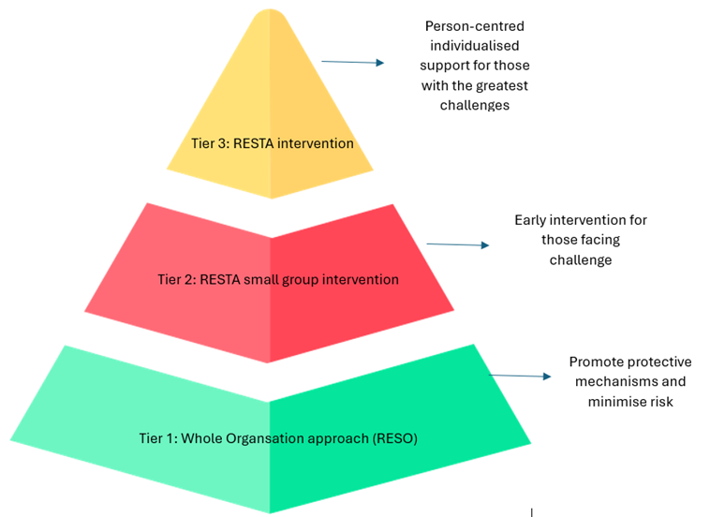

RESO - Resilience Support Organisation
Notes:
Resilience Support Teaching Assistants (RESTA)
The College has achieved Resilience Support Organisation (RESO) status, recognising its commitment to promoting educational resilience and wellbeing across the learner community. This approach supports improved attendance, retention, and achievement by ensuring learners feel safe, supported, and able to engage positively with their learning. Central to this strategy is the creation of a strong sense of belonging and a consistent, College‑wide approach to supporting learners.
RESTA practitioners are defined as professionals who use person‑centred, relational approaches to build trust, demonstrate compassion, and work collaboratively with learners to support positive change. As part of the College’s tutorial strategy, RESTA principles will be embedded within the Personal Development (PD) curriculum to support early identification and intervention for learners who may benefit from additional emotional or wellbeing support.
ePASS tutorials provide an opportunity to identify learners who may require RESTA intervention. Link Tutors and Progress Tutors will work in collaboration with RESTA practitioners to refer learners for targeted support where emerging concerns are identified. This ensures that resilience support is integrated seamlessly into existing tutorial structures rather than operating as a standalone provision.
RESTA interventions will be delivered on an individual or small‑group basis over a period of approximately 8 to 12 weeks, led by a designated RESTA practitioner. The intervention programme is designed to support learners’ emotional wellbeing, personal growth, and readiness to engage successfully with their learning.
The focus of RESTA intervention will include developing learners’ connectedness, emotional awareness, values, coping strategies, motivation, and aspirations for the future. By embedding RESTA within the tutorial strategy, the College strengthens its wrap‑around support offer, promoting resilience, growth mindset, and wellbeing as core enablers of learner success.

Slide 14

Developing exam resilience
Normalising exams
Starter activities – an exam questions
In lessons referencing tasks back to exams
Mock papers
Having a go as the workings out gain marks per question
Mixing high and low stakes questions
Embedding ‘exam language’ whilst decoding
Off Course Support
Additional support focus on specific questions or subjects
English & Maths Instructors - additional support
Demystifying exams
Talking about assessments for the start of the course – preparing, readiness
Videos and voiced powerpoint – bitesize information about statement of entries, transport, rules and regulations
Familiarity with exam spaces
Communication with parents to echo these messages
Exam days
Clear instructions and guidance
Support on day with familiar faces
Help desks
Notes:
Refer to 7 ways resource as an example end point.

Slide 15
Ideas for next year’s strategy
Two layers of English - G2/G3
A greater emphasis on confidence building, resilience and fostering a sense of belonging will feature in the G2 groups.
The G2 groups will follow a unitised/modular approach to foundational topics (as suggested in the CAR), and end-of-topic assessments will be rewarded with internal certificates.
There is an acknowledgement that learners’ commitment to English and maths could be fragile. Teachers will adopt a RESO (relational) approach to foster a sense of belonging. Strong teacher/learner relationships are important.
Tutors will utilise grade progress measures (2-, 2, 2+, etc.) to track proximity to grade boundaries and instil incremental student confidence.
Notes:
Refer to 7 ways resource as an example end point.

Slide 16


