Slide 1
New Leader Induction at The Sheffield College
From onboarding to impact: a milestone-based approach

Slide 2
The Challenge We Were Solving
Inconsistent onboarding experiences across teams
Lack of clarity for new leaders in their first 12 months
Limited visibility of development progress
Disconnected between strategy and day-to-day leadership
Over reliance on informal/ variable support

Slide 3
Our Design Principles – what we wanted to achieve
Simple and intuitive to use
Clear, structured 12 month journey
Embedded in existing systems (not another thing)
Aligned to strategy, values and behaviors
Flexible for different roles and experience levels
Accessible anytime (not just at induction)

Slide 4
The Solution – A milestone based New Leader Development Plan
A 12 month structured journey
Built into iTrent
Each milestone = simple task(s)
Direct links to guidance via SharePoint
Supported by:
Always-on Leadership Toolbox
Mandatory core learning
Live induction experience

Slide 5
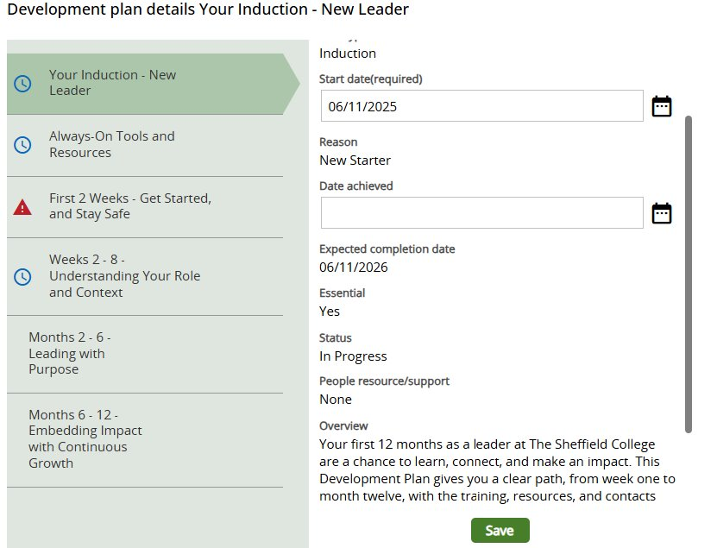
How It Works (User Experience) Simple, guided, intuitive
New leader logs into iTrent
Sees milestone tasks
Clicks link – taken directly to SharePoint site
Completes activity
Clicks Link to track progress

Slide 6
The 12 Month Journey – structured but flexible
Weeks 0 – 2 Get started and stay safe
Weeks 2 – 4 Understanding your role and context
Months 2 – 6 Lead with Purpose
Months 6 – 12 Embed impact and grow
Plus:
Leaders can move in/ out of milestones
Content accessible anytime

Slide 7

What Makes It Different – why this works
Focus sessions with leaders from both curriculum and professional services
Role neutral but context specific
Blends
  Compliance
  Culture
  Capability
Not just induction, it’s ongoing development

Slide 8
Leading With Purpose – face to face event
Fully day, in person experience
Focus:
Peer connection
Strategy, Values and Behaviours
A day in the life of…
Reflection

Slide 9

Intended (Early Indicators / Intended Outcomes
More consistent onboarding experience
Increased leader confidence
Clear expectations
Stronger alignment to strategy
Improved visibility of development

Slide 10
What We Learned
Keep it simple
Build within systems
Co-create
Blend digital and face to face
Make it flexible

Slide 11
Quick Demo…
…. Any Questions?

