Slide 1

Improving Health & Safety Performance
This Photo by Unknown Author is licensed under CC BY-NC

Slide 2

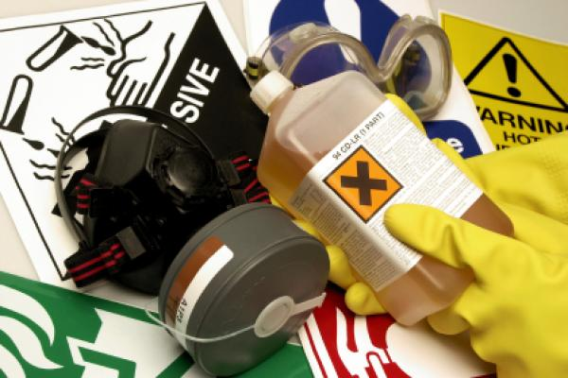

Introduction
Improving Health and Safety health and safety in FE settings is not only about legal duty—it’s about creating a safe, supportive, and professional environment that enables learners and staff to thrive.
How can we set the framework for health and safety and then influence others to “buy into the vision” as professionals

Slide 3

Review/Define the Standards by which the college adheres to – these set the expectations and should be tenaciously applied.
Review the “Frame” of policy by which the college wishes to be judged by (the vision).
Review how leadership is demonstrated – visible felt leadership (doing the right things, being seen to do the right things and “being believed”).

Slide 4
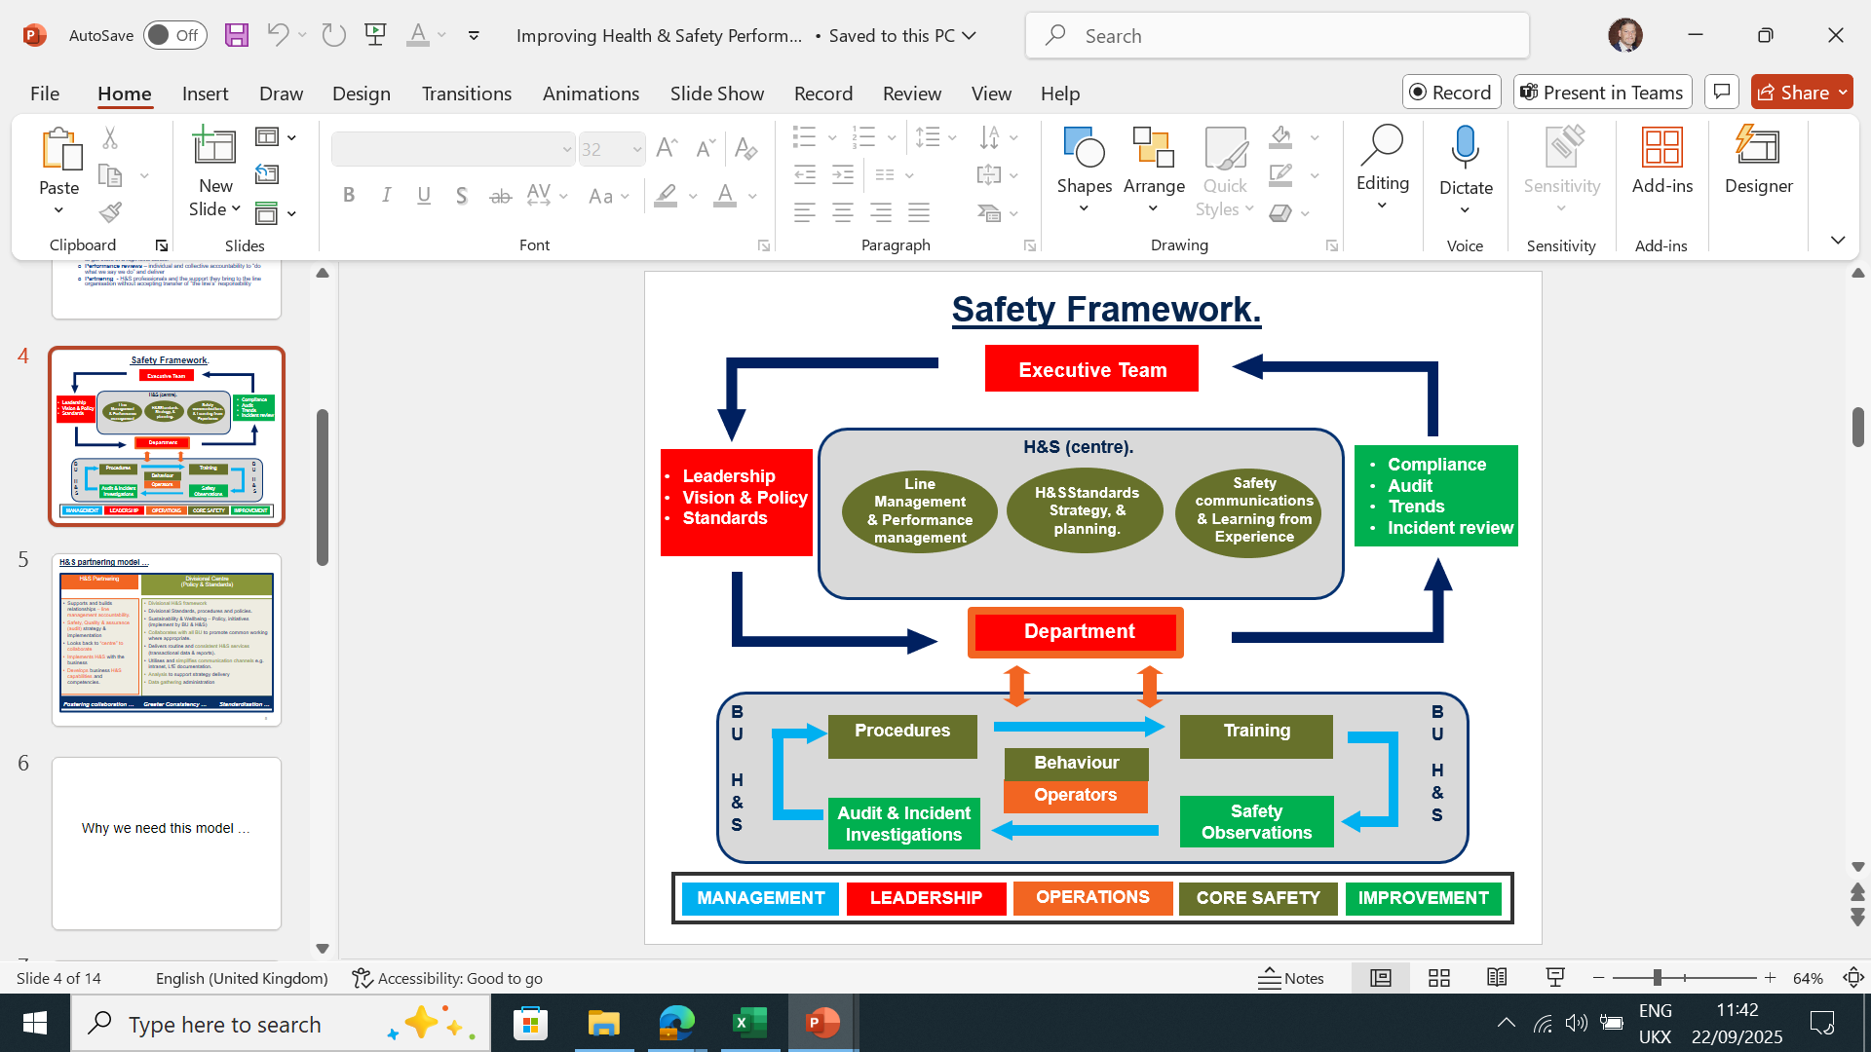

Slide 5
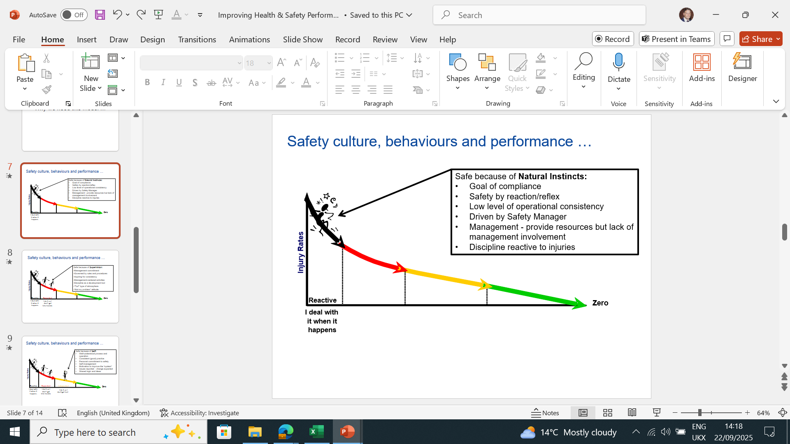

Slide 6
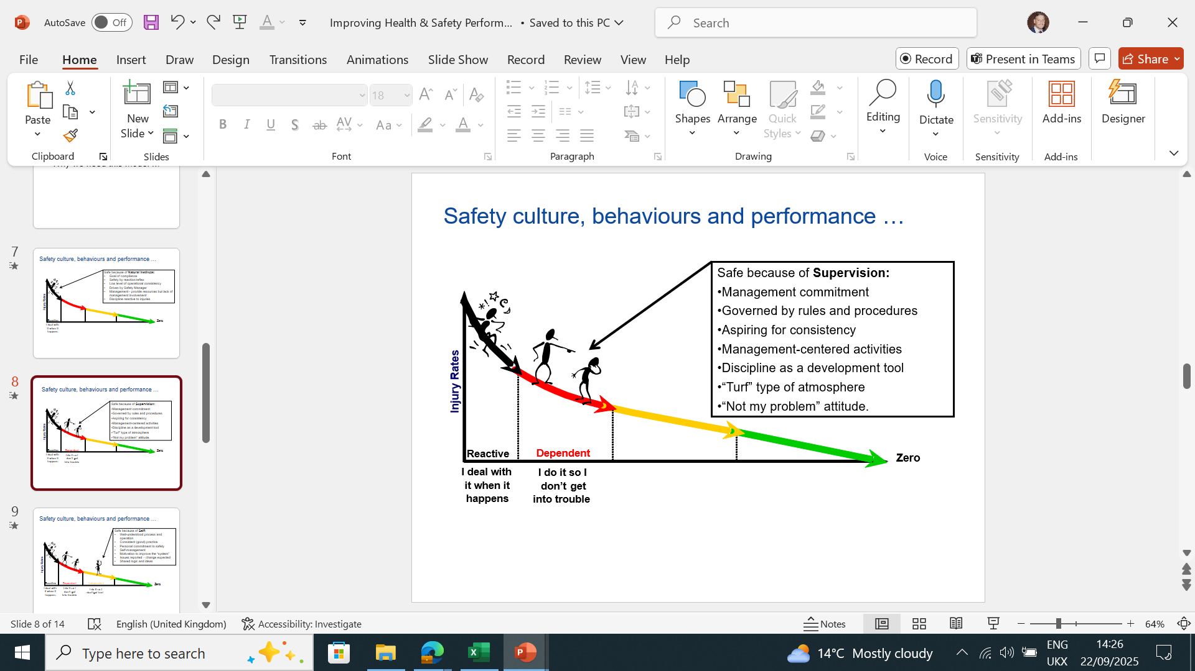
Improving HEALTH AND SAFETY

Slide 7
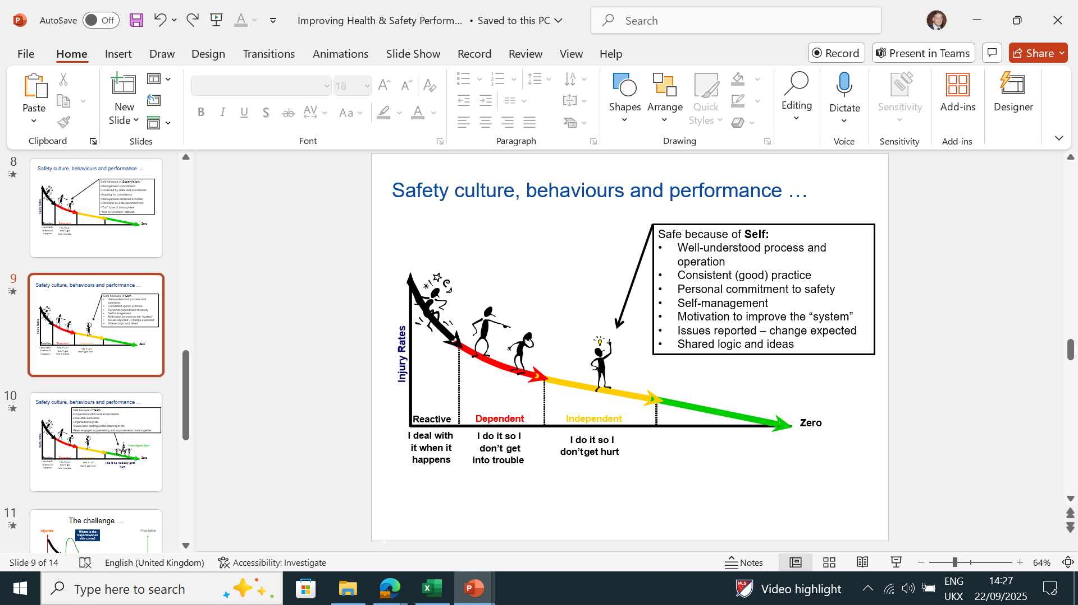

Slide 8
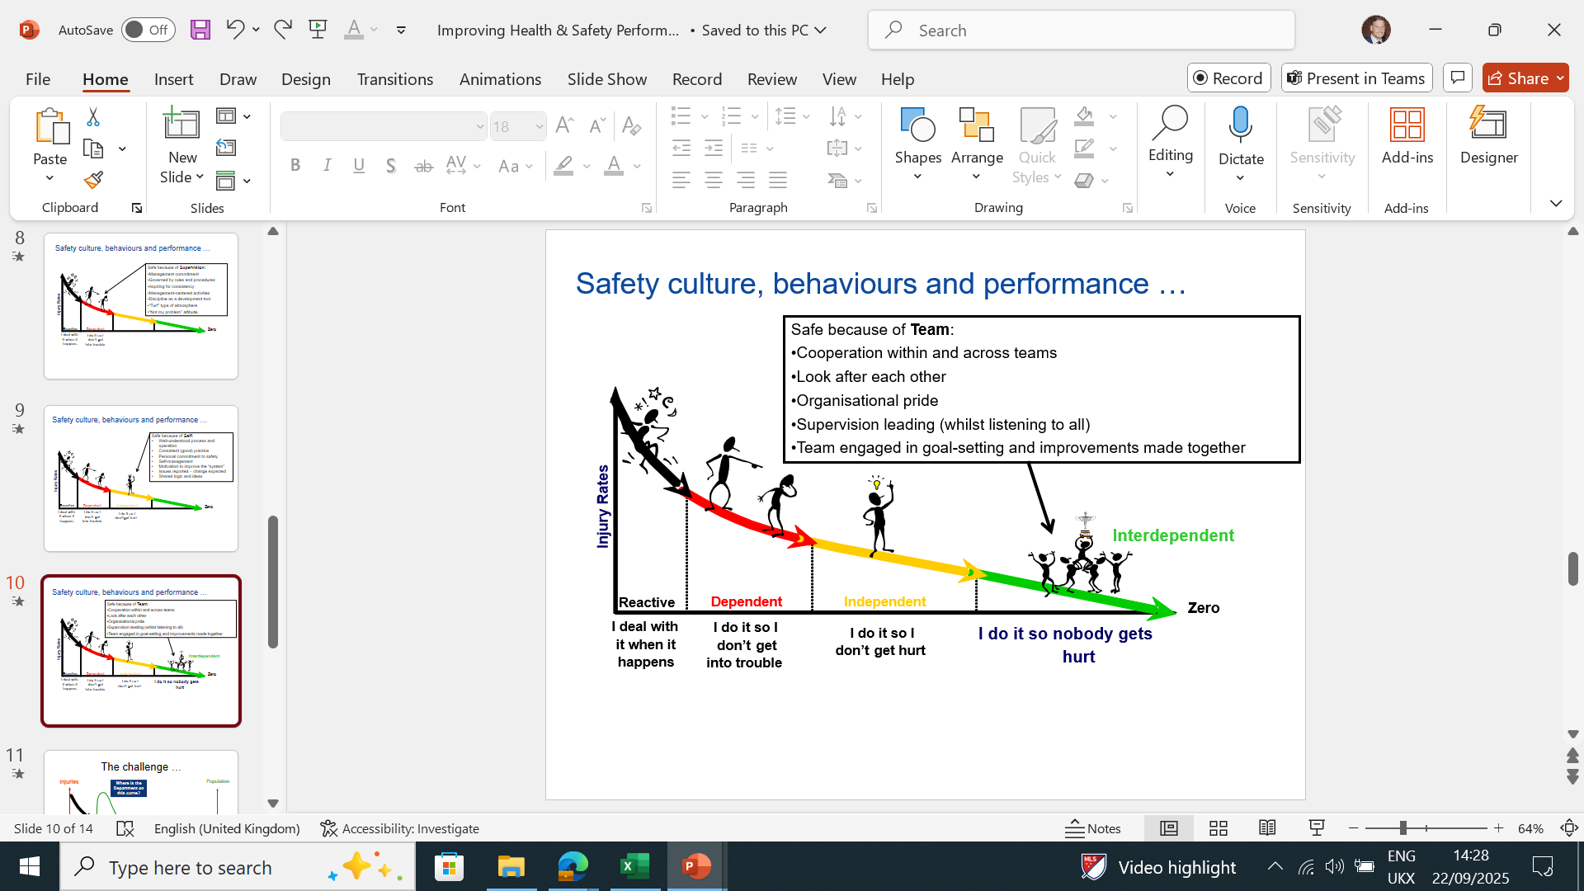

Slide 9
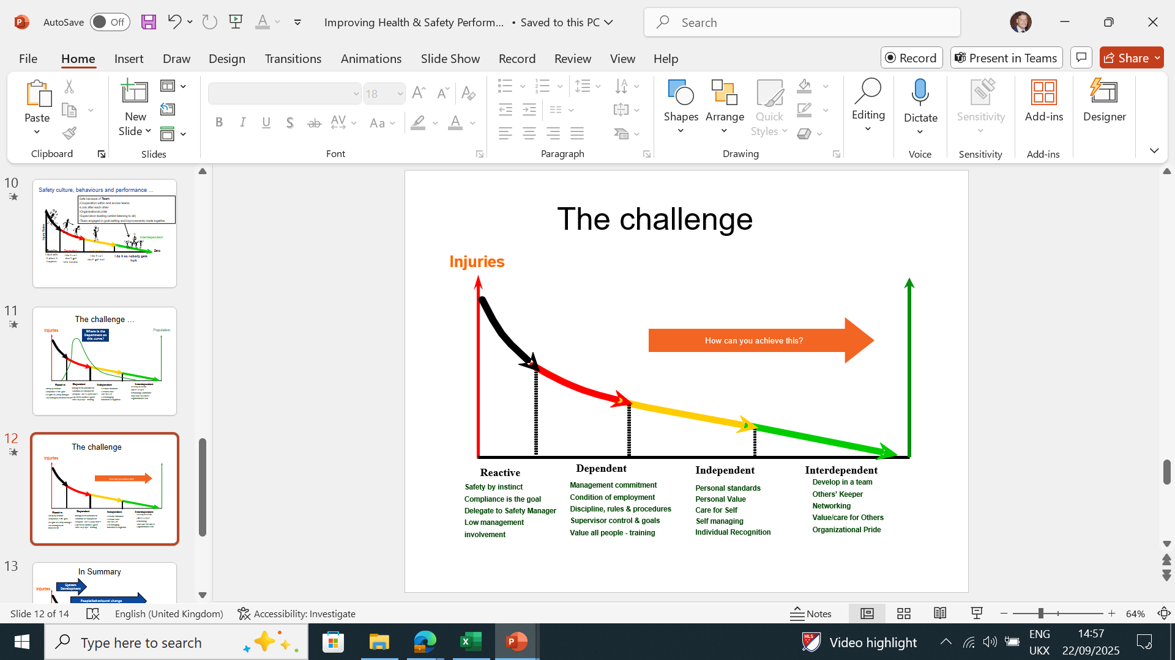
Improving HEALTH AND SAFETY

Slide 10
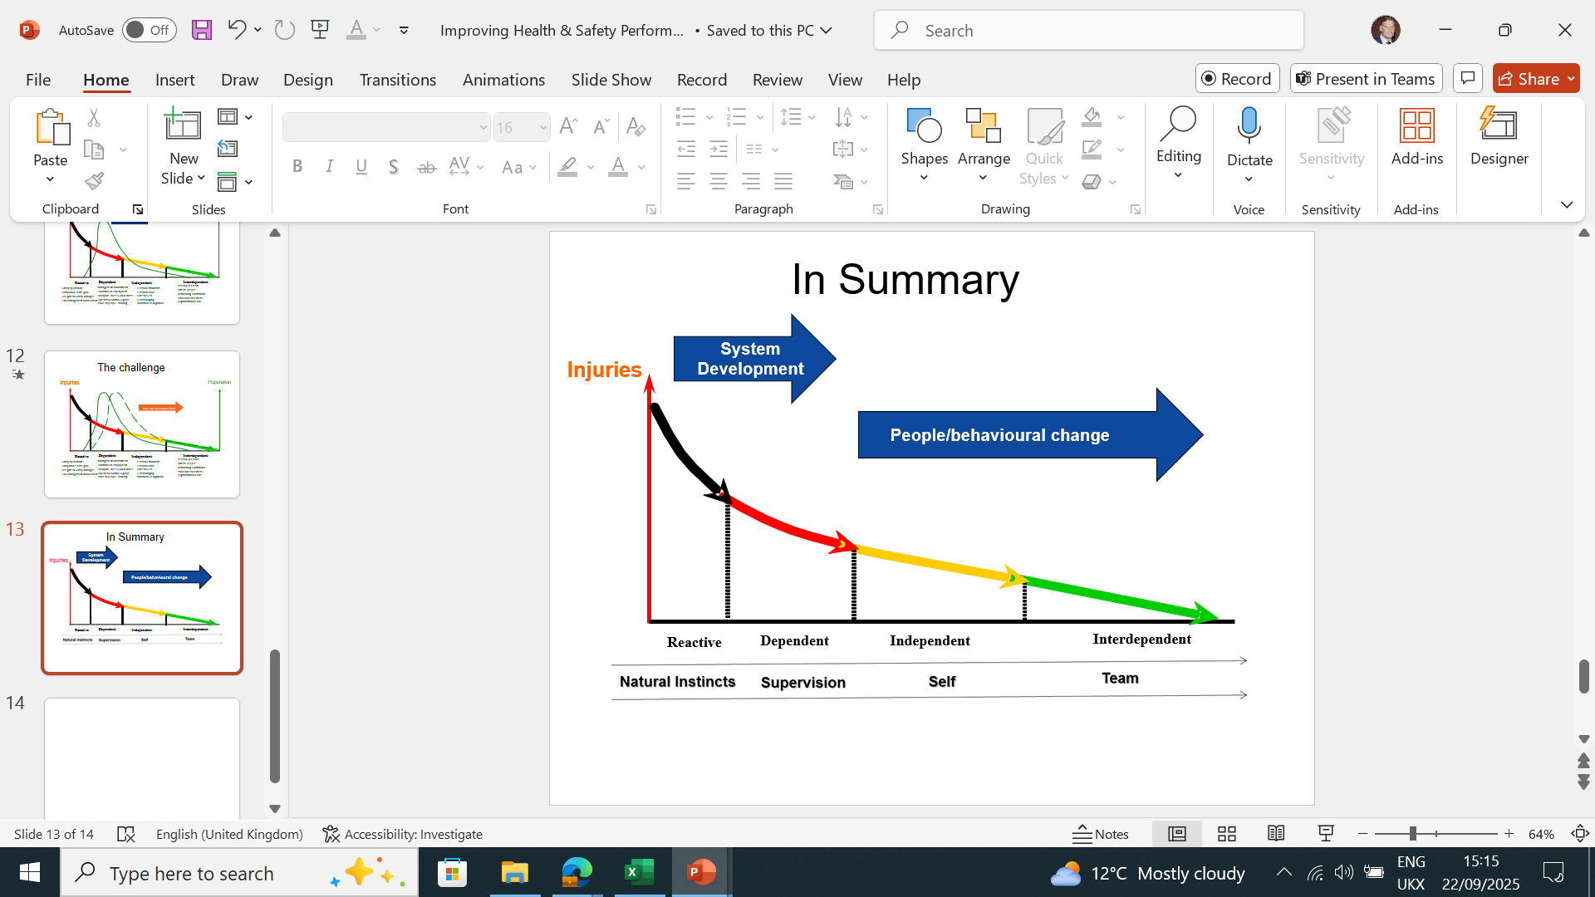
Natural Instincts
Supervision
Self
Team
Improving HEALTH AND SAFETY

Slide 11
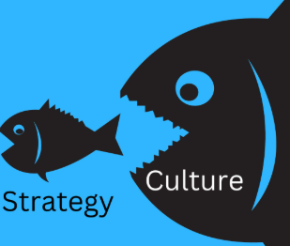
CULTURE (Eats Strategy for Breakfast)
(Peter Druker)
Culture is created by the behaviours you tolerate. If you will tolerate bad behaviour, people will learn they can get away with it… create a culture of "open and honest" feedback, and make sure it goes both ways.
Change starts at the top. Often, the leader will not be open to change, and it can be in their body language or becoming defensive… You can’t expect your people to change if you’re not willing to change first.
The leader needs to recognizes that they are ‘a voice’ around the table, not ‘the voice.’ Leaders often see themselves as the only person capable and authorised to make decisions. While it’s true that they need to make the decisions, they also need to listen honestly and without showing impatience for other people’s opinions.

Slide 12
Make health & safety believable — and get people to act
Short answer: believable H&S comes from credibility + clarity + practicality + social proof.
Core principles (the foundation)
Be credible — use real, local, recent examples and trusted messengers (supervisors, peers, union reps, safety champions).
Be clear & specific — one clear action per message (not a list of ten), with exactly how, when, and where.
Make it doable — remove barriers (tools, time, space) so the right action is the easy action.
**Show consequences (not threats) — explain what happens and why, using facts and human stories rather than abstract rules.
Use social proof & norms — highlight peer behaviour: “9 out of 10 teams wear X.”
Demonstrate care — people respond to messages that show leaders genuinely care about their wellbeing, not just compliance.
Feedback + recognition — measure, share results, and celebrate safe acts.
Enforce fairly — rules without consistent follow-up lose credibility; apply consequences but combine with coaching.
Practical tactics you can implement today
Lead by example. Make supervisors visible doing the behaviours. Short, public acts from leaders multiply influence.
Micro-training: 5-minute demos at shift start showing exactly what to do. Repeat often.
Active listening: ask workers what gets in the way — fix those obstacles and then communicate the fix.
nudge design: put PPE at point-of-use, tape footprints to show safe route, use default choices (e.g., PPE pre-packed with tools).
Visual cues & short signage: one-sentence instruction + icon. Avoid overload.
Stories, not stats: share a 30–90 second real story of someone helped/avoided harm because of one correct action.
Peer champions: recruit respected peers and let them teach or call out good practice publicly.
Quick audits + immediate feedback: 15-second spot checks with on-the-spot praise or coaching.
Make it measurable: track leading indicators (observations, toolbox talks) not just incidents.

Slide 13
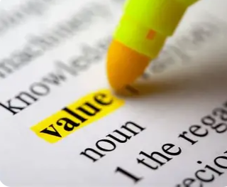
Safety as a Value or Safety as a priority
“An ounce of prevention is worth a pound of cure” perfectly captures the essence of building a strong safety culture. True safety leadership requires more than words—it demands visible commitment, especially from the top.
Leaders must show that safety is a core value, not just a shifting priority, by addressing unsafe behavior consistently, even when it’s inconvenient. When leaders align their actions with their words, employees take notice and follow suit.
A lasting safety culture thrives when everyone, starting with leadership, models the standard: “Do as I say, and as I do.” That consistency can save lives.

Slide 14
Question…
To take this group forward do we focus on the strategic or how to practically get things done by sharing best practice...or a bit of both?
Improving HEALTH AND SAFETY

Slide 15
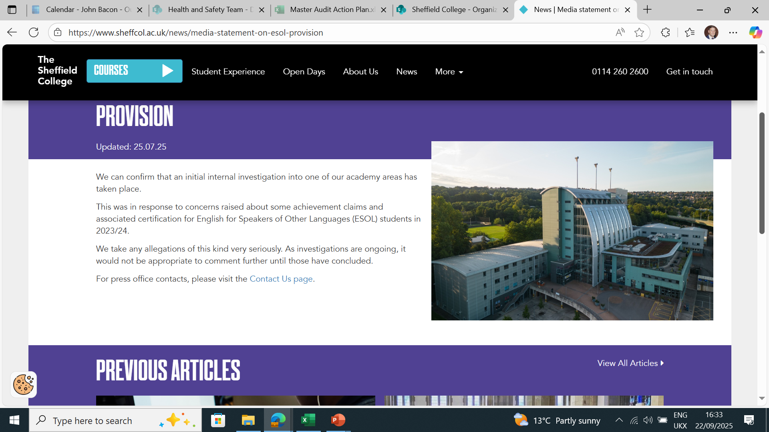
Thank you
John Bacon CMIOSH
John.bacon@sheffcol.ac.uk

