Slide 1


The College Collective

Slide 2

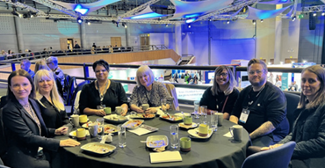

Post 16 Reform and Transition Planning
Dr Kate Webb
Managing Director of The KWP Ltd

Slide 3
Introduction
The College Collective helps colleges grow their own expert talent while sharing knowledge and best practice across the UK. It brings together forward-thinking colleges that collaborate to provide a peer-led consultancy and professional development model.
At the heart of the model is a simple idea. Every college has something of value to offer, and something of value to learn.

Slide 4
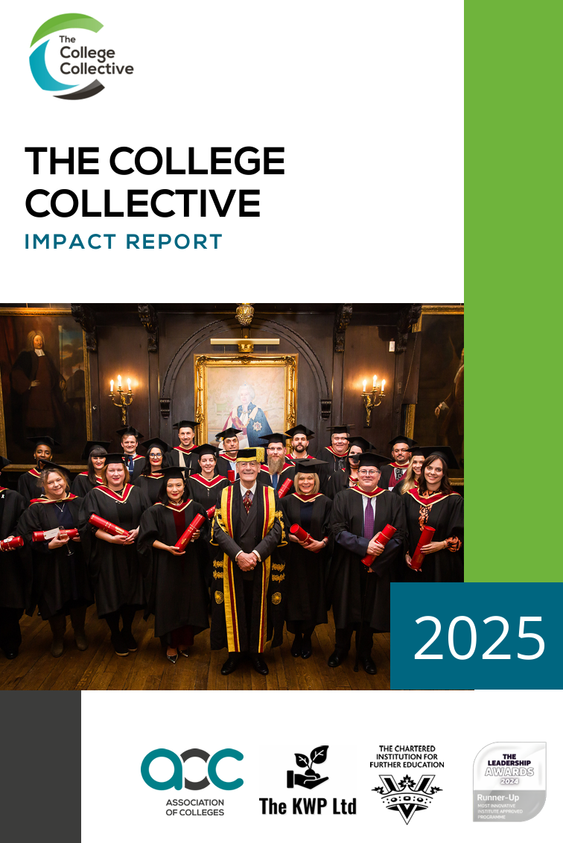
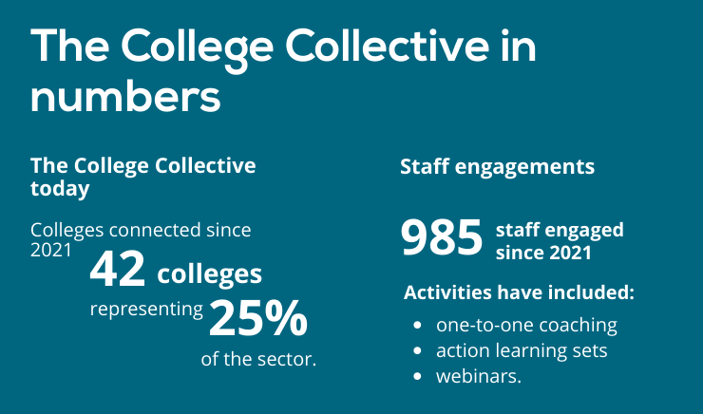
Impact

Slide 5
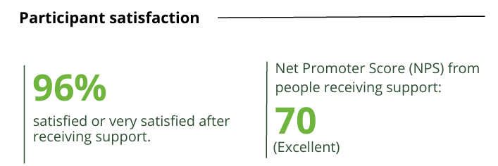
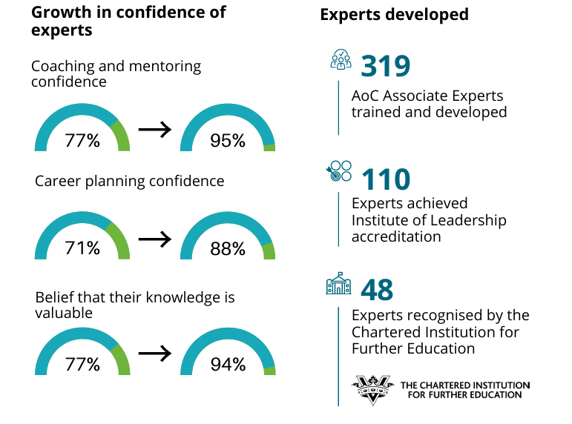


Impact

Slide 6
Purpose of This Session
To provide a brief overview of qualification reform and the Post-16 Pathways Implementation Plan
To have an open debate about transition planning and the Strategic Transition Planning Statement (STPS)
To share thoughts, practice and plans

Slide 7
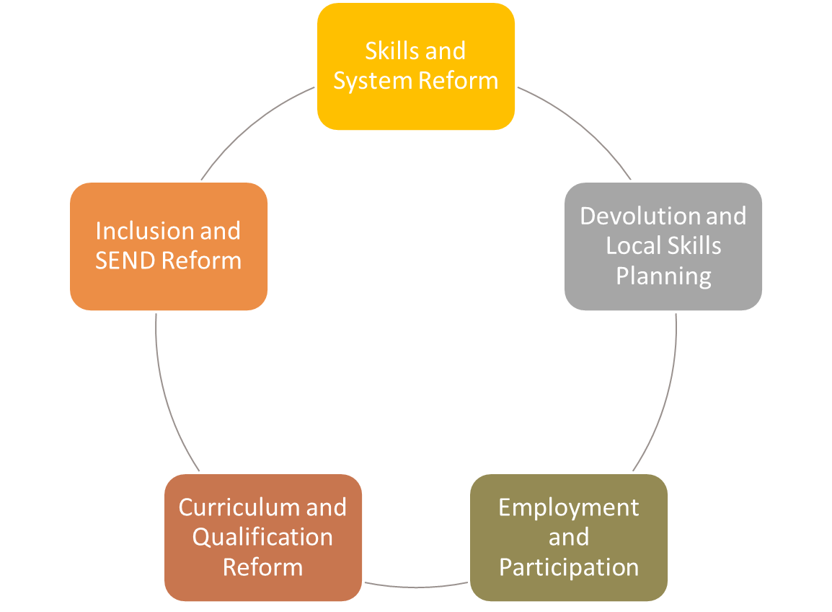
Reform on All Fronts

Slide 8

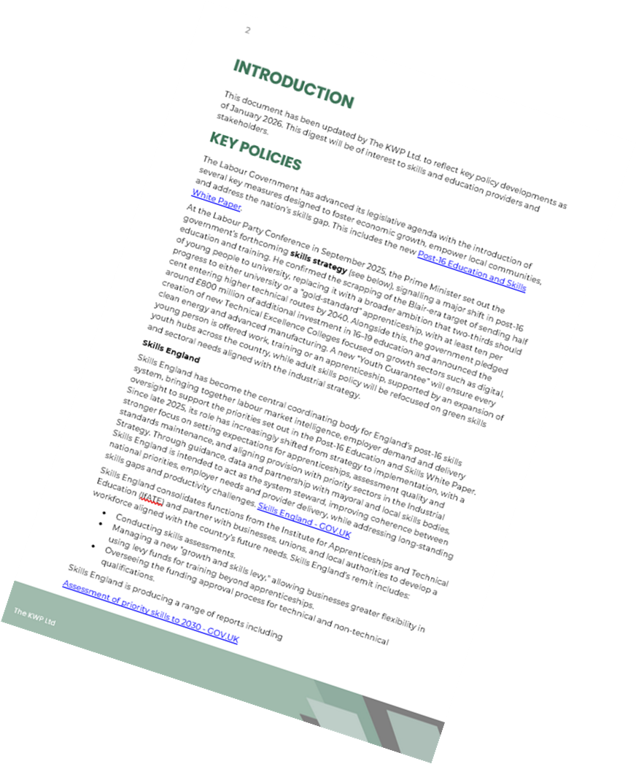
Policy Digest

Slide 9
Policy Digest
Academic year | L2 qualifications defunded | L3 qualifications defunded | New V Levels | New T Levels | New L1 or L2 qualifications introduced
2026–2027 | None | None | None | None | Consultation on Level 1 English and maths qualifications
2027–2028 | Education and early years | Finance and accounting; Digital; Education and early years (plus large ≥1080 GLH qualifications in existing T Level subjects) | Digital; Education and early years; Finance and accounting | None | Occupational Certificates: Catering and hospitality; Education and early years. Foundation Certificates: Digital; Education and early years
2028–2029 | Business and administration; Care services; Construction and the built environment; Digital; Engineering and manufacturing; Health and science; Legal, finance and accounting; Sales, marketing and procurement; Sports, fitness and exercise science | Business and administration; Care services; Construction and the built environment; Engineering and manufacturing; Health and science; Legal; Sales, marketing and procurement; Sports, fitness and exercise science; Health and social care (large qualifications) | Business and administration; Care services; Construction and the built environment; Engineering and manufacturing; Health and science; Legal; Sales, marketing and procurement; Sports, fitness and exercise science | Care services; Sports, fitness and exercise science | Occupational Certificates: Business and administration; Care services; Construction and the built environment; Digital; Engineering and manufacturing; Finance and administration; Health and science; Sports and leisure. Foundation Certificates: Business, administration and law; Care services; Construction and the built environment; Engineering and manufacturing; Health and science; Sports, fitness and exercise science
2029–2030 | Agriculture, environmental and animal care; Hair and beauty; Horticulture and floristry | Agriculture, environmental and animal care; Catering and hospitality; Hair and beauty; Protective services | Agriculture, environmental and animal care; Catering and hospitality; Hair and beauty; Protective services | Catering and hospitality; Creative and design (expansion); Hair and beauty; Protective services | Occupational Certificates: Agriculture, environmental and animal care; Hair and beauty; Horticulture and floristry. Foundation Certificates: Agriculture, environmental and animal care; Catering and hospitality; Hair and beauty; Protective services
2030–2031 | Art and performing arts; Creative and design; Travel and tourism; All remaining legacy Level 2 qualifications | Art and performing arts; Creative and design; Travel and tourism; All remaining legacy Level 3 qualifications | Art and performing arts; Creative and design; Travel and tourism | Art and performing arts; Travel and tourism | Foundation Certificates: Art and performing arts; Creative and design; Travel and tourism

Slide 10
Post 16 Implementation Plan
Which V Levels, T Levels and level 2 qualifications will be taught in 2027/28 and 2028/29, and the subject areas in scope for later years.
Key policy decisions for early delivery, including on partnered V Levels and rules of combination in 2027/28.
New provision, including two new T Levels (Sport and Social Care) and the establishment of a Technical and Vocational Higher Education network.
Improvements to assessment and delivery of T Levels and removing barriers to industry placements.
Plans for transition and changes to qualification funding approval.

Slide 11
2027/28
Roll out by academic year | Occupational Certificates | Foundation Certificates | V Levels | T Levels
2027 to 2028 | Education and Early Years Early Years Practitioner Catering and Hospitality Culinary Skills Hospitality (Food and Beverage Team and Accommodation Team) | Digital Systems and Data Education and Early Years | Accounting and Finance Digital Systems and Data Education

Slide 12
2028/29
Occupational Certificates (final list to be confirmed early 2027) | Foundation Certificates (final list to be confirmed early 2027)
Business and Finance Accounts and Finance Assistant, Assistant Administrator Digital Administration | Business, Administration and Law
Health and Care Services Adult Care Worker, Healthcare Support Worker | Health and Care Services
Construction (On-site) Bricklayer, Carpentry and Joinery, Stonemasonry | Construction and the Built Environment
Construction (Finishing Trades) Domestic Plumber, Floor Layer, Painter and Decorator Plasterer, Wall and Floor Tiler
Engineering and Manufacturing Autocare Technician, Engineering Operative, Furniture Making, Welder | Engineering and Manufacturing
Healthcare and Science Healthcare Science Assistant, Pharmacy Services Assistant | Science
Sports and Leisure Community Sport and Leisure Operations | Sport Fitness and Exercise Science

Slide 13
2028/29
V Levels(final list to be confirmed early 2027) | T Levels (final list to be confirmed early 2027)
Applied Research and Technology Construction Design Engineering Design Engineering and Manufacturing Health Healthcare and Clinical Technologies Legal Services Leisure, Exercise and Sports Management, Procurement and Supply Chains Marketing and Retail Social Care | Social Care Sport
Applied Research and Technology Construction Design Engineering Design Engineering and Manufacturing Health Healthcare and Clinical Technologies Legal Services Leisure, Exercise and Sports Management, Procurement and Supply Chains Marketing and Retail Social Care
Content development for V Levels, Foundation Certificates and Occupational Certificates to be taught in the 2028 to 2029 academic year will start in July 2026. The content consultation will launch in November 2026 and subject content is due to be published in early 2027.
If you would like to get involved in helping to develop subject content, email post16level2and3.delivery@education.gov.uk indicating the subject you would like to support.

Slide 14
Level 2 Pathways
The Further Study pathway is for students who want to progress to level 3 (T Levels, V Levels or A Levels). Students study a one‑year Foundation Certificate that provides broad vocational knowledge, with subjects formulated and mapped to V Levels and T Levels to support clear progression pathways. 250-300 GLH, 1 Year
The Occupational pathway is for students aiming for relevant skilled employment at level 2, or an apprenticeship. The Occupational Certificate will provide sector knowledge, transferable skills and occupation-specific content aligned to the occupational standards published by Skills England. 540-720 GLH- 2 Years
“Where possible, we are developing the content for both the Foundation Certificate and Occupational Certificate in parallel, enabling alignment and overlap in content where appropriate.
This could support co-teaching of both pathways by providers to help with delivery to students. As part of the Post-16 L2 and L3 qualifications: 2027 proposed subject content, common content has been mapped across both certificates.”

Slide 15
V Levels
V Levels are 360 guided learning hours (GLH) each the same size as an A Level. Students will be able to take V Levels in multiple subjects and in combination with other qualifications, such as other V levels, A Levels and, where required, level 2 and below English or Maths to form a broad study programme.
Optionality
Partnered V Levels
Rules of Combination- For the 2027 to 2028 academic year, DfE will not implement any rules of combination on which qualifications can be combined to form the qualification element of a study programme.
Where students want to take a large programme within a route, they should take a T Level rather than combining multiple qualifications, which will better support their progression.

Slide 16
T Levels- the only large (1,080GLH) qualification
V Levels, Foundation Certificates, Occupational Certificates and T Levels will be eligible for funding through the Adult Skills Fund in non-devolved areas.
New T Levels in 2028- Social Care and Sport; and in 2029 Catering, expansion of creative, expansion of land based, hair & beauty and protective services; in 2030 travel & tourism and performing art and art.
Withdrawal of Finance (2026 final cohort)
Review of existing T Levels (starting with Health and Science)- reduction in assessment burden and time
New guidance for Industry Placements-

Slide 17
T Levels- Industry Placement New Approaches
The updated industry placement framework moves away from a "one size fits all" model, allowing providers and employers to combine different approaches to create high-quality, sector-relevant experiences while maintaining employer oversight and meaningful workplace learning.

Slide 18
T Levels- Industry Placement New Approaches
New Placement Approach | What It Means | Flexibility for Providers and Employers
Traditional Placement | Single employer placement for the full duration (315+ hours) | Remains the preferred model where capacity exists
Multiple Employers | Placement hours split across employers | Broadens opportunities where a single employer cannot provide all hours
Part-time Employment | Relevant paid work can count towards placement hours | Recognises existing employer relationships and reduces placement sourcing challenges
Route or Pathway Placements | Placement linked to the wider T Level route rather than a specific occupational specialism | Expands the range of suitable employers and placement opportunities
Remote Working | Placement hours completed remotely where appropriate | Supports sectors with hybrid working practices, particularly digital industries
Small Team Projects | Employer-led projects delivered with groups of students | Enables engagement with employers unable to host individual placements
Skills Hubs and Training Centres | Industry-standard training environments supervised by employers | Helps overcome capacity constraints while developing technical skills safely
Provider-based Placements | Activities delivered on provider sites with employer oversight | Creates opportunities for learners with SEND or where external placements are limited
Work Taster Activities | Short sector exposure activities (up to 35 hours) | Helps students explore career options before committing to a placement
Flexible Timing Models | Day release, block release or blended delivery | Allows placements to fit employer operational needs and curriculum requirements

Slide 19
Transition Planning Statement
Collects high level information of intent to deliver from 2027/28
Discussion:
Main challenges of implementation of T Levels, V Levels, Occupational Certificates and Foundation Certificates
Main risks of implementation of T Levels, V Levels, Occupational Certificates and Foundation Certificates
Potential changes to wider support- e.g tutorials
How are you framing the marketing and communications

Slide 20

Find Out More
Natalie.gee@aoc.co.uk
kate@thekwp.co.uk
The College Collective | Association of Colleges (aoc.co.uk)

