Slide 1


Slide 2

College Collective HR ALS
Thursday 23 April 2026
Staff Forums – giving our employees a voice
Julie Symons, HR Manager
Notes:
• Overview of staff forum structure and membership
• How staff forums are used to gather staff voice and influence decisions
• Benefits, challenges and lessons learned
Discussion and Q+A

Slide 3
Specialist SEND college for 16-25 year olds
Centenary celebration in 2027
 Student population  185
Gobowen |  | Telford | Ludlow
Residential | 99 | 35 | 10
Day | 38
Notes:
Derwen is a specialist college and a charity that supports people who may have moderate, severe, complex or profound and multiple learning disabilities. We work with
Students, on educational programmes
Clients, on social care funded packages
Guests of our short breaks provision
We are celebrating our centenary next year so we have been a part of the community for a long time, and thus we recruit heavily from the local community
We have 182 students across 3 sites with majority here at our Gobowen site and this is where our residential students are based
We also have a commercial arm, Premier Inn, garden centre, café and restaurant. These are open to the public and our students and clients are able to get work experience here
Also worthy of note is the fact we do not have any recognized trade union involvement. Whilst we work with TU representatives on an individual basis we do not have any collective agreements in place.

Slide 4
Total workforce = 490
Notes:
Total workforce of 490
as you can expect from the fact we are a residential college, over half of those staff 60% are care staff
a quarter are our teaching and learning staff
Approx 20% are support staff or staff employed in our commercial outlets
Here in the HR team we are a team of 3 – I report into a director, then we have a recruitment administrator, a HR administrator and a payroll coordinator

Slide 5
Gathering Voice
 Online feedback (individual voice)
 Staff forum (collective voice)
 Other informal channels of communication
Notes:
I asked AI what employee voice was and it told me that
Employee voice is the way employees express their views, concerns, and suggestions to influence decisions at work, enhancing engagement, wellbeing, and organisational performance
Employee voice refers to the ability of employees to communicate their opinions, concerns, and ideas to their employer and have them considered in decisionmaking processes.
It can occur individually or collectively, formally through surveys, consultation groups, or staff forums, and informally via team meetings, intranets, or social media platforms.
Effective employee voice relies on complementary channels supported by leadership, where managers actively listen and act on feedback
Two main ways we actively seek employee voice
We have a portal on our intranet entitled Staff Voice where employees can provide anonymous feedback on any aspect of their working life.
We have a staff forum which is a formal way of gathering staff forum
But also there are all the informal ways such as building the employee:line manager relationships. Its about enabling employees to feel comfortable about speaking out about issues

Slide 6
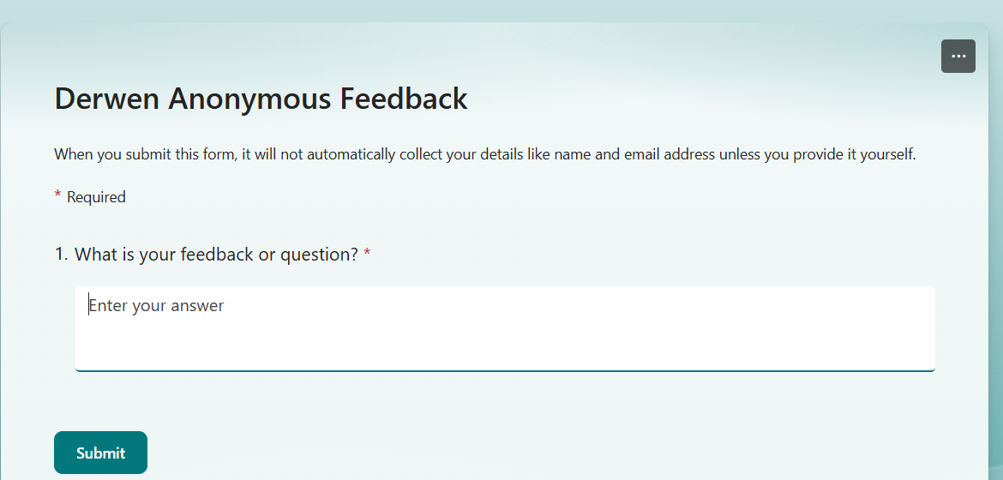
Online feedback
Notes:
Created in MS Forms
Quick method of providing feedback
Received by HR team who take to Staff Forum
Anonymous

Slide 7
 Formal
 Internal collective group of staff
 Governed by a Constitution & Terms of Reference
 How it is made up
 How it influences decisions
Staff Forum
Notes:
The purpose of our forum is to act as an information and consultation body and provide an opportunity for dialogue and an exchange of views. The ToR is also clear about what the forum is not, eg not for collective bargaining or to undermine existing channels of communication
Membership – all staff up to but excluding the senior leadership team. Members are elected by their peers. We currently have 18 staff representatives sitting on the forum
Meets 3 times per year (once per term)
Agendas are set and we in HR are the secretary for these meetings

Slide 8
Benefits
 Employees feel “heard”
 Creating a culture of trust
 Good ideas!
Notes:
Because members of the SLT attend our forums and speak directly with reps, they are really visible. The aim is that the forum is seen as a credible way for employees to feel listened to and valued
Building relationships well means that trust increases and staff feel able to speak out, and know that this can be done appropriately through the channels Derwen offer
As I said we are heading towards our centenary next year and have used the forum as a way to push information out to staff and seek their input. We’ve had some really good ideas, including getting our vehicles “wrapped”, so getting our logo on our vehicles and the centenary logo

Slide 9
Challenges
 Recognising the value of employee voice amongst the challenge of being a busy (stretched!) HR team
 Staying relevant – thinking of other ways to capture all voices within our workforce
Ensuring the forum is used in the way in which it is intended
Notes:
I have been in this role 18 months now. I have to say that Derwen values employee voice highly in my opinion. However, here are 3 of the main challenges I have faced
I’ve found it is easy to let the ability of our employees to have a voice slip down the priority list, especially when juggling the different priorities of our senior leadership team, eg ER, staying compliant, staying on top of recruitment. However the longer I’ve been involved in the forum, the more I can see the importance of employees feeling as though they have been heard.
As I said at the beginning, around 60% of our workforce are care staff. Due to their role and the shift nature of their work, attending meetings during 9-5 is not a priority for them – they are supporting our students of course. However, the majority of the elected members who attend regularly are from the curriculum directorate so it is about ensuring the voices that are heard are representative of the workforce and that the message that is coming from the members is not biased
Considering other ways to run the forum – whether tech could be used?
The election process – how to reach under represented groups within the workforce
Human nature is such that we all like a good old whinge from time to time, myself included! It is a challenge keeping everyone aware of the function of the forum and what is appropriate to bring to the meeting.
However, we have seen the value of a pre-forum meeting whereby elected members on their own to collate items they would like discussed and this then goes to the SLT for triage and anything not appropriate for the forum gets dealt with separately

Slide 10
???
 Do you capture employee voice?
 How do you do it?
 Do you have any tips or tricks to share?
Notes:
Thank you very much for your time,

