Slide 1

How to facilitate online meetings and sessions
In the chat- complete this sentence
“An online meeting is working well when….”

Slide 2


The College Collective

Slide 3
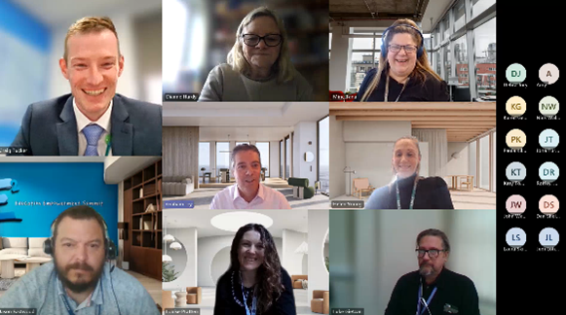
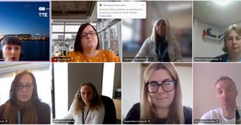
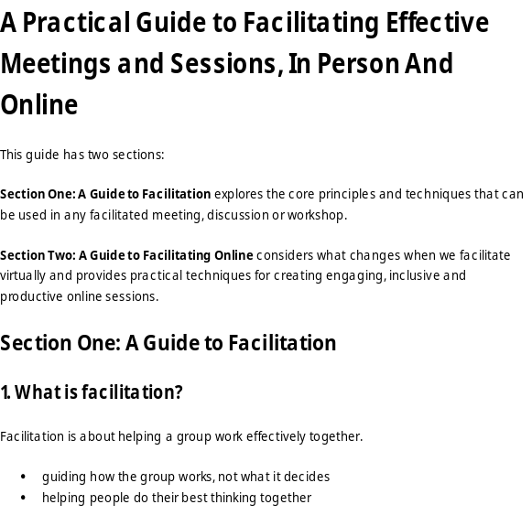

How To Facilitate Online Workshops
Dr Kate Webb
Managing Director of The KWP Ltd
thekwp.co.uk

Slide 4
How to facilitate online meetings and sessions
In the chat- complete this sentence
“An online meeting is working well when….”

Slide 5
This Session is an Experiment
Understand what is different about facilitating on-line
Experience practical ways to engage and include people
Look at inclusion, engagement and difficult situations
Know how to move an online group from discussion to action
Notice not only WHAT we do today but HOW we do it

Slide 6

What Makes Online Meetings or Sessions Difficult?
THINK for 30 seconds
TYPE your response into the chat but
DO NOT press send yet

Slide 7

On a scale of 1–5, how confident do you currently feel facilitating an online meeting or session?
1 = I find it quite challenging
2 = I have some confidence, but it can feel uncomfortable
3 = Generally comfortable
4 = Confident
5 = Very confident
Online Needs MORE Facilitation, Not Less
Direction- Where are we going?
Energy- Are people still with us?
Progress- Are we getting somewhere?
The facilitator guides HOW the group works

Slide 8


Any Thoughts?
Take 30 seconds to think…
Put one thought in the chat…
Let’s hear briefly from everyone…
Show me one to five….
Let’s hear from someone we haven’t heard from…
In pairs, agree your Top Two…
Vote for the one you’d take forward…
Online participation needs to be designed

Slide 9
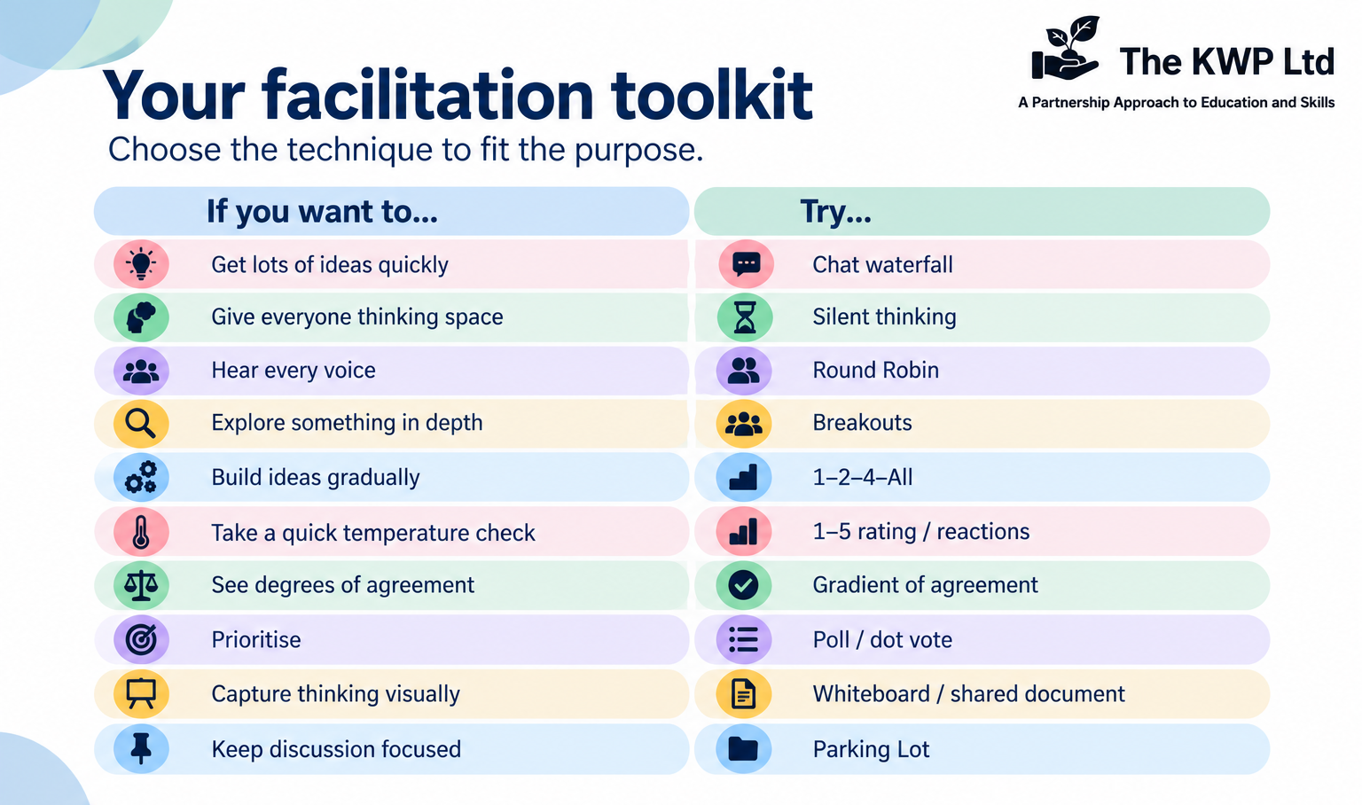

Slide 10
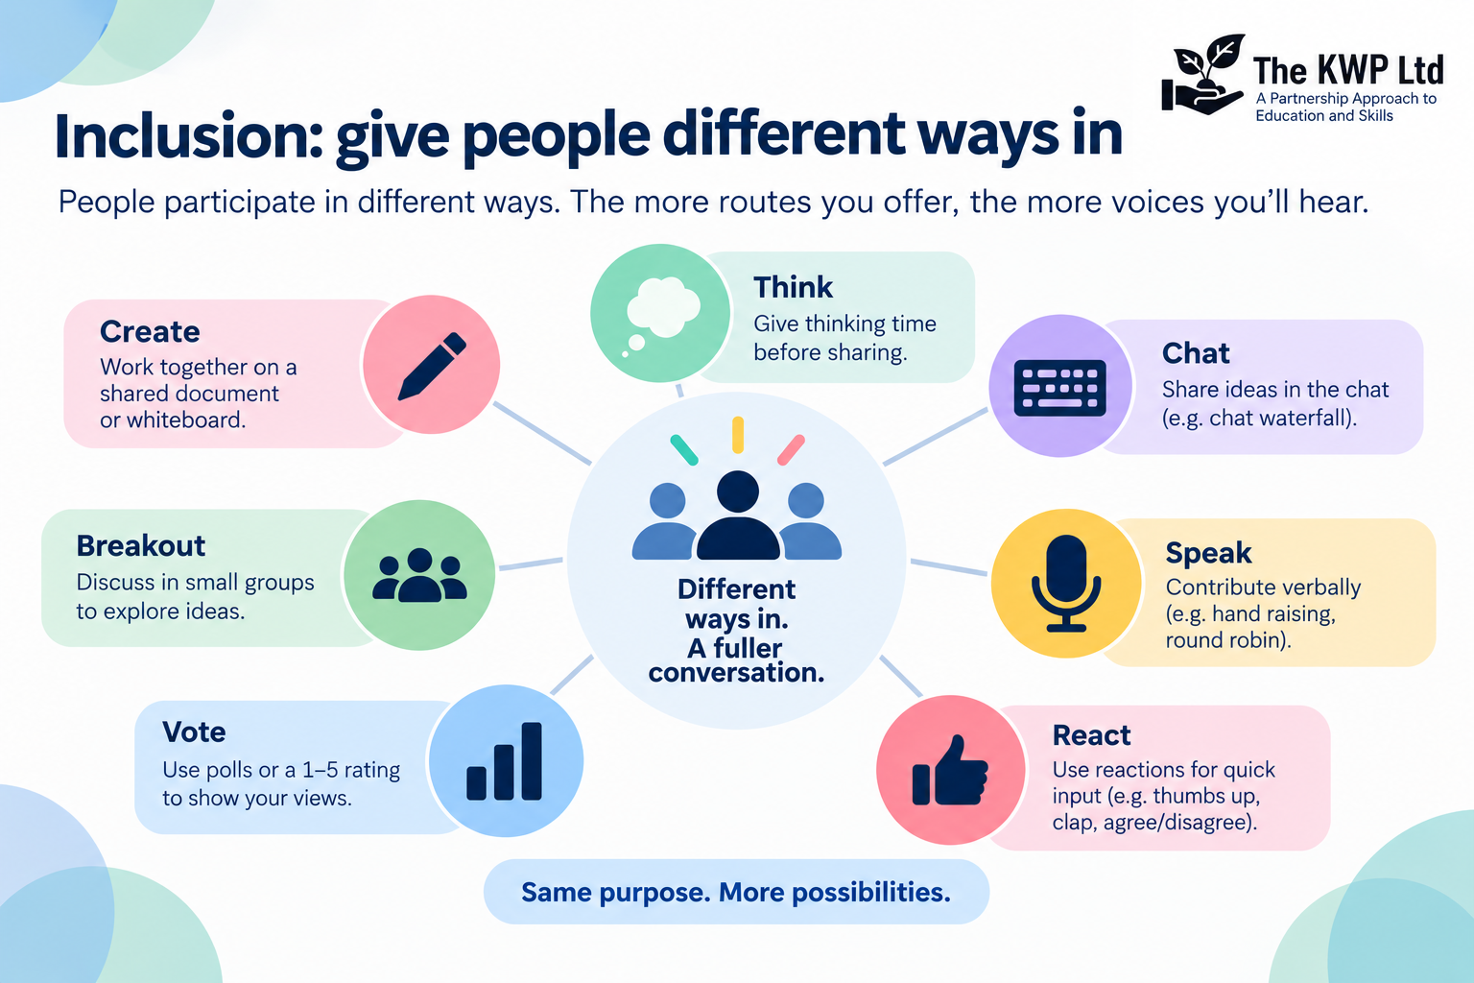

Slide 11
Breakout Challenge: WHAT WOULD YOU ACTUALLY SAY?
A One person is dominating the conversation
B Nobody responds to your question
C The same few people are doing all the talking
D The discussion has gone off track
Choose ONE.
Agree the actual words you would SAY as facilitator.
5 minutes
When you return, put your best phrase in CHAT.

Slide 12
Breakout Challenge: WHAT WOULD YOU ACTUALLY SAY?
Dominating
“I'm going to come in there, because I'd like to make sure we hear some other perspectives.”
Silence
“That's quite a big question. I'm going to give everybody 30 seconds to think before we hear responses.”
Same voices
“I'd particularly like to hear from anyone who hasn't contributed yet.”
Off track
“That's useful, but it isn't where we need to focus today. I'm going to park it so that we don't lose it.”

Slide 13
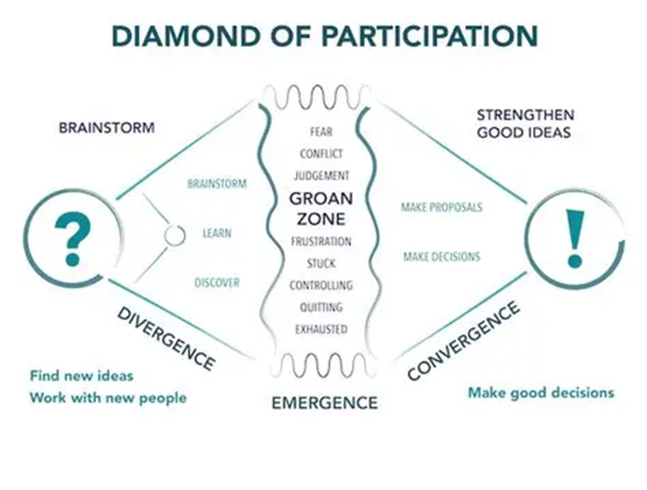
Help People Know Where They Are Going
OPEN → EXPLORE → NARROW → CLOSE
OPEN
What else?
EXPLORE
What are the different perspectives?
NARROW
What matters most?
CLOSE
What have we agreed?
“We've heard lots of different ideas. I'm going to move us now from generating possibilities to deciding which ones we want to take forward.”

Slide 14
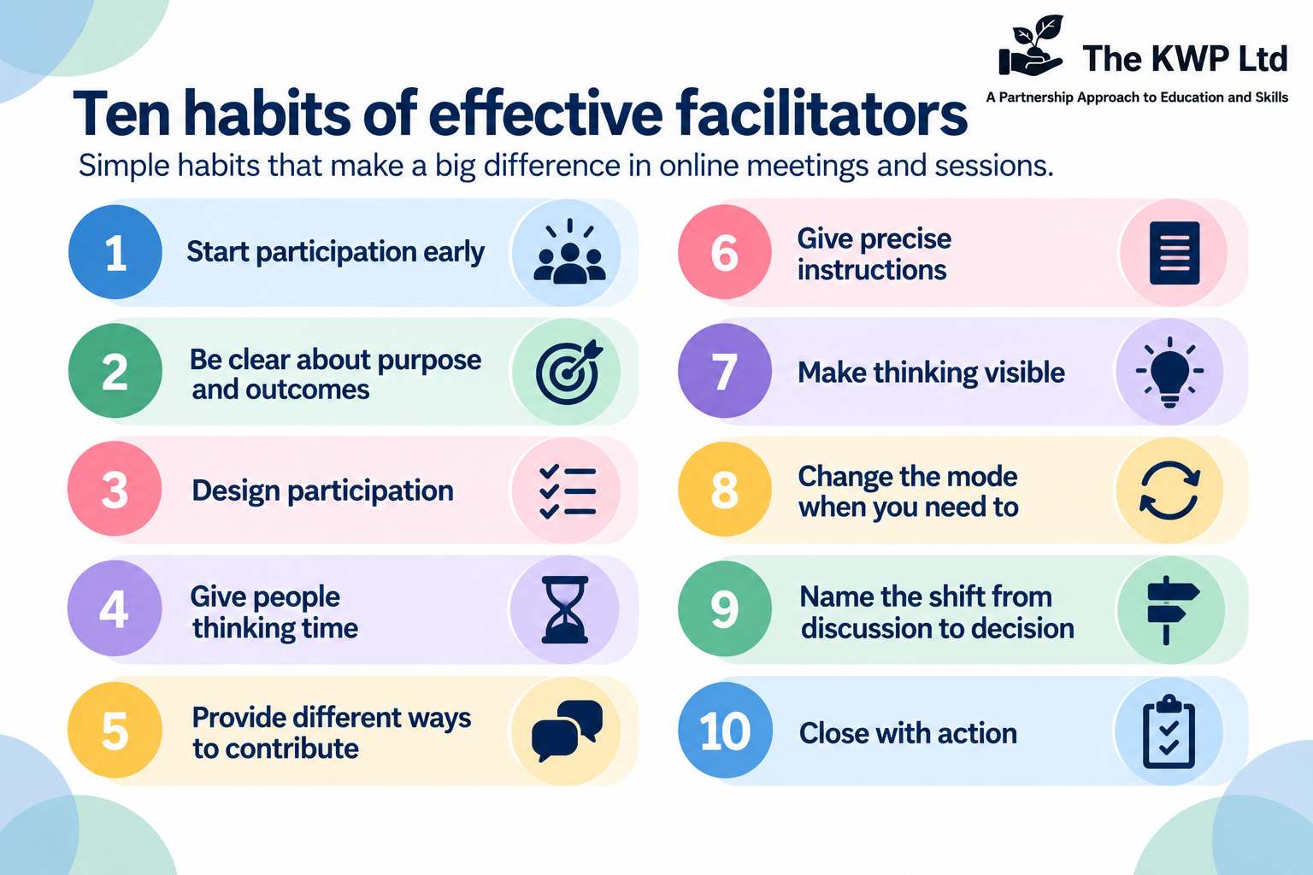

Slide 15

Discussion isn’t the Outcome
YOUR TURN
Think about your next online meeting or session.
What ONE thing will you do differently?
AGREEMENT ACTION OWNER WHEN
What have we agreed?
What happens next?
Who owns it?
By when?

Slide 16
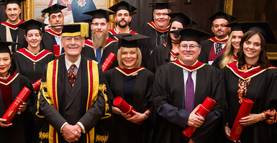
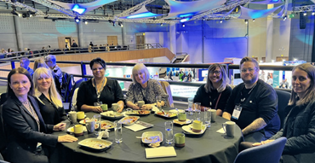
Slides, recording and a Guide from The KWP will be sent to you
www.thekwp.co.uk

Slide 17
More ways to get involved in The College Collective
Ask your line manager about receiving a match from an AoC Associate Expert
Ask your line manager about becoming an AoC Associate Expert
Our new website has a library of resources
Our on-line groups and webinars are open to all members of staff from a partner college-
Health & Safety
Marketing
AI and Digital
MIS
Sustainability
English and maths
ESOL
SEND
Behaviour
Qualification Reform

Slide 18

Find Out More
nat@thekwp.co.uk
Further Education Consultancy | The College Collective

